Slide 1


Minor Project
Welcome

Slide 2
Speaker- Identification over Call Records
Submitted to: Mr. Mradul Dhakar
Submitted By:
Atul Anand
BETN1CS15028
CSE-A(3r^{d} Yr.)
Bharti Parmar
BETN1CS15032
CSE-A(3r^{d} Yr.)
Ankit Kumar
BETN1CS15017
CSE-A(3r^{d} Yr.)

Slide 3
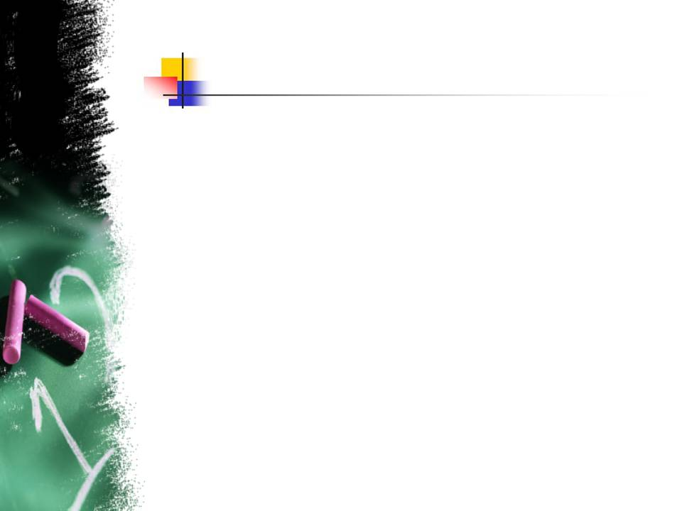
Outline
Introduction
Technology
Literature Review
Feature Extraction
Libraries
Model Training
System Analysis
Result
Future Scope

Slide 4
Introduction
Speaker Recognition: The speaker recognition task can be performed in two ways: Text Dependant (Speaker Verification) or Text Independent (Speaker Identification).
Speaker Verification: To perform speaker verification, one must use the same data for training and testing purpose. Viz. train data and test data are same. It is basically 1: 1 recognition system; in which identity of 1 speaker is matched and verified with the claimed identity of 1 speaker in audio sample.
Speaker Identification: To perform speaker identification, different train and test data is used. It is basically 1: N recognition system; in which identity of 1 speaker is matched with N speaker’s voice samples stored in the training model.

Slide 5
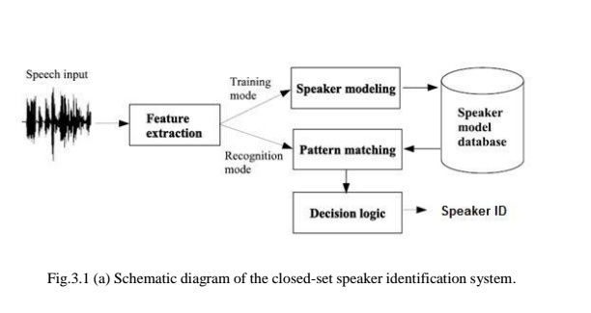
Speaker Recognition

Slide 6
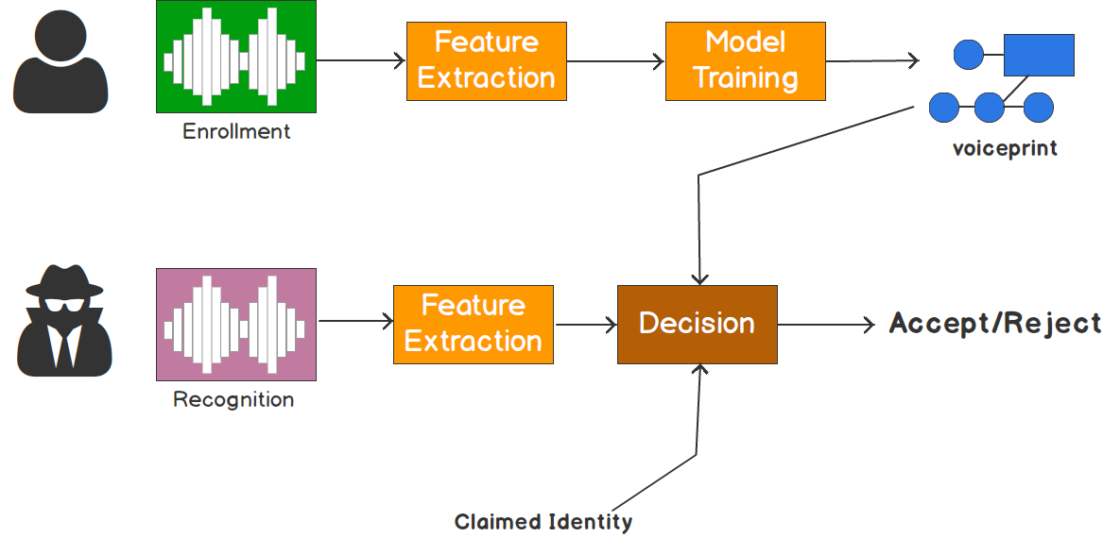
Speaker Verification

Slide 7
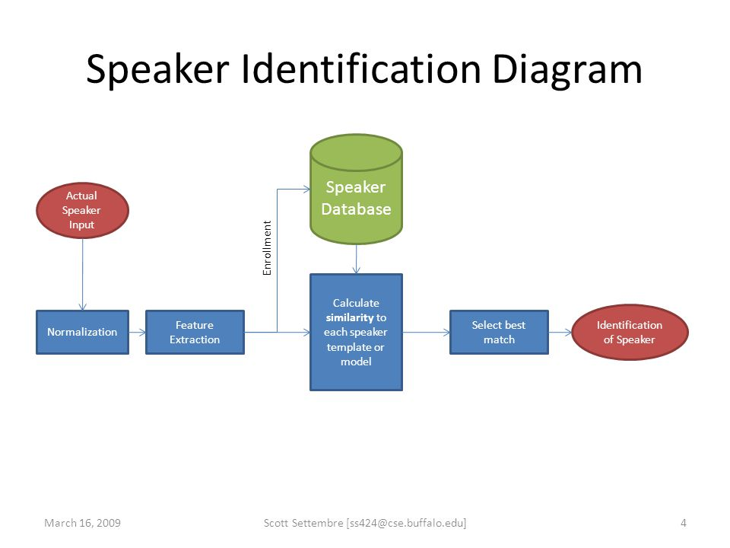
Speaker Identification

Slide 8
Technology
Language: python 2.7
Library: python_speech_features
Features: MFCC + Delta-MFCC
Model training: GMM
-> Speaker recognition is a “pattern recognition” problem.
-> Spectral features are predominantly used in representing speaker characteristics. ( Cepstral is invert of Spectral)
-> The various technologies used to process and store voice prints include frequency estimation, hidden Markov models (HMM), Gaussian mixture models (GMM), pattern matching algorithms, neural networks (ANN or MLP), matrix representation, and decision trees.

Slide 9
Concept behind Audio Analysis
no two persons in the world have exactly the same voices.
Our vocal cords can be in any of about 170 different positions.
The pitch of voice depends upon the length of the vocal cords.
Each voice has a certain range of frequencies. It is this range that determines the kind of voice a person has.
The movement of the tongue against the palate, the shaping of the lips and arrangement of teeth also bring about changes in the voice. Since the structures and movements of all these organs are different in different persons, the voices of no two persons in the world can be identical.

Slide 10
Literature Review
There are many open issues in the field of automatic speaker identification. Among them, the choice of the appropriate speech signal features and machine learning algorithms could be mentioned.
We believe MFCC-GMM model is most appropriate based on parameters like identification accuracy, computation time, false rejection, and false acceptance rate.
The proposed system is a version of voice biometric which incorporates text independent speaker identification implemented independently.

Slide 11

Neural Nets for Speaker Identification
The recent application of deep neural networks (DNN) to speaker identification (SID) has resulted in significant improvements over current state-of-the-art on telephone speech.
Two approaches to DNN-based SID:
1.) one that uses the DNN to extract features,
2.) that uses the DNN during feature modeling.

Slide 12
Classical Machine Learning Models
The classical machine learning models to train an audio dataset somehow revolves around Gaussian Mixture Model (GMM) and Hidden Markov Model (HMM).
GMM can be thought of as a single state HMM.
-> Why GMM is preferred?
1.) Though, GMM is preferably used because it is more reliable than HMM, although HMM possess more accuracy.
2.) Secondly, GMM yields output much faster than HMM.
3.) It consumes optimal resources than compared to HMM.
Most of the times either of them are used independently or with a DNN (deep neural network). However, sometimes they both can be used together in combination.
Choosing any of the above prescribed approach is Arts-more-than-Science.

Slide 13
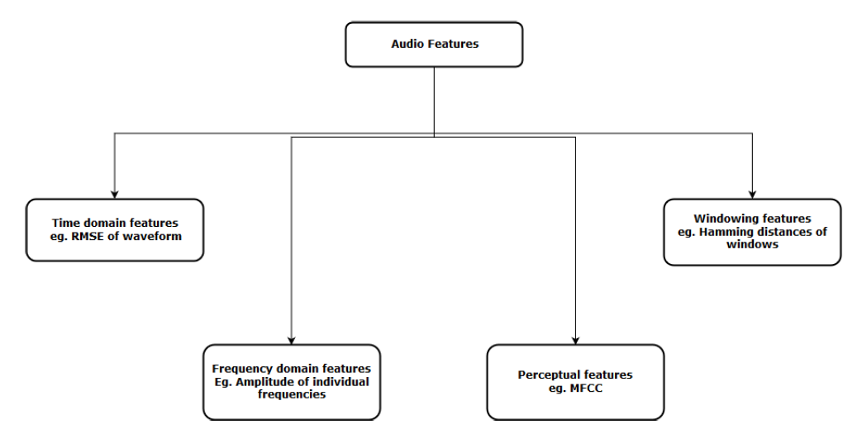
Feature Extraction Techniques

Slide 14
Libraries
pyAudioAnalysis
YAFFE
LibROSA
Essentia
python_speech_features
Scikits.Talkbox

Slide 15
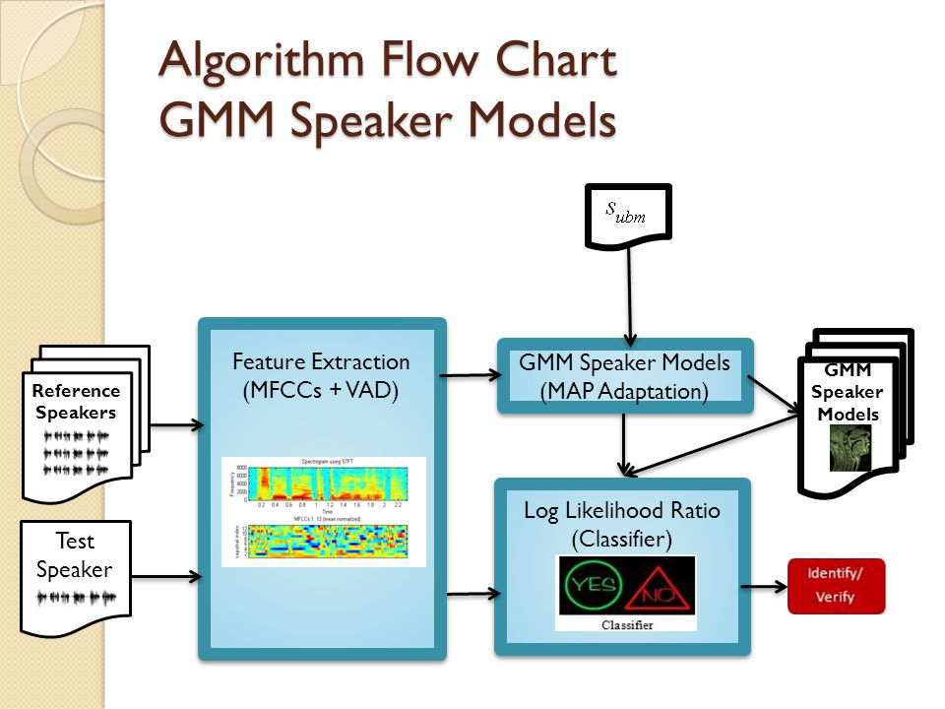
Proposed Methodology

Slide 16
Process
-> This can be summarized in 5 basic Phases:
Data Acquisition
Data pre-processing
Feature Extraction
Model Training
Perform Testing (identification)

Slide 17
Data Acquisition:
-> Though we tested our model’s working and accuracy on a downloaded dataset; viz. VoxForge DATASET. But, to check its reliability and correctness; we also prepared a dataset by ourselves. It was voice recording of our friends, colleagues, and relatives.
So, we had two datasets in particular:
VoxForge Dataset
Manual self-made Dataset

Slide 18
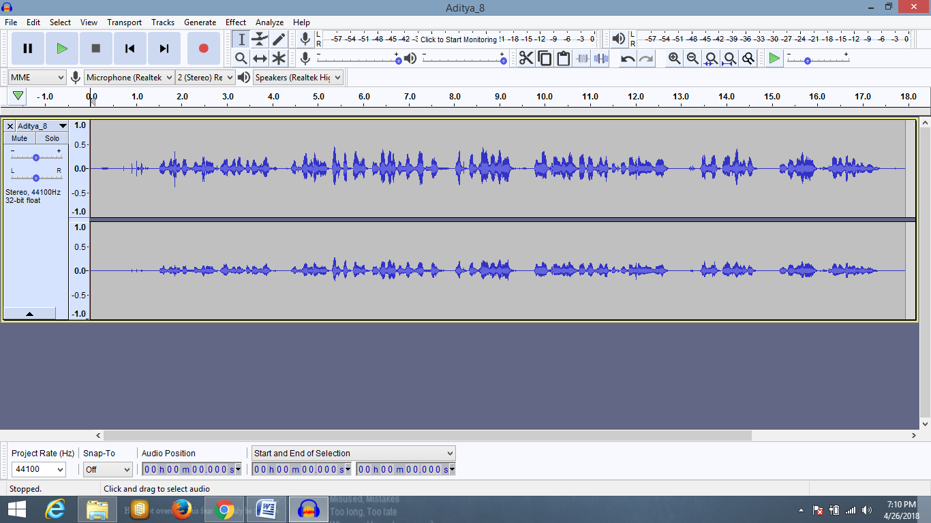
Data preprocessing:
The data must be pre-processed in order to achieve better outputs and prediction results.
This is to ensure that the model is trained with minimum errors.
VoxForge dataset was already clean and noise free. So, we just skipped the pre-processing part in its case.
Noise Reduction + Silence Removal:
Conversion from .mp3 to .wav format:

Slide 19
Feature Extraction:
-> we are focusing on two main features MFCCs and their Derivatives, say Delta-MFCC.
-> We calculated 20 MFCCs and 20 Delta-MFCCs.
-> So, totally we had 40 features in hand.
-> Delta MFCC was calculated by a custom defined function under featureextraction.py module.

Slide 20
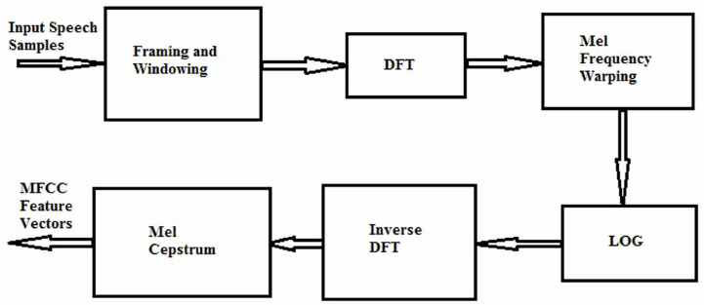
Mel frequency Cepstral coefficient (MFCC) estimation
Mel Frequency Cepstrum Coefficients (MFCC) to extract features in the voice signal. MFCC focuses on series of calculation that uses Cepstrum with a nonlinear frequency axis following Mel scale. To obtain melcepstrum, the voice signal is windowed first using analysis window and then Discrete Fourier Transform is computed. The main purpose of MFCC is to mimic the behavior of human ears.
-> MFCC estimation includes following process.
-> MFCC process subdivided into six phases or blocks.

Slide 21
Model Training:
We implemented the GMM approach for model training.
The speaker identification system module can be separated into four modules:
Front-end processing
Speaker modeling
Speaker database
Decision logic

Slide 22
Modeling: GMM
sklearn.mixture is a package which enables one to learn Gaussian Mixture Models (diagonal, spherical, tied and full covariance matrices supported), sample them, and estimate them from data.
-> A Gaussian mixture model is a probabilistic model that assumes all the data points are generated from a mixture of a finite number of Gaussian distributions with unknown parameters. One can think of mixture models as generalizing k-means clustering to incorporate information about the covariance structure of the data as well as the centers of the latent Gaussians.
-> Speaker database: The speaker models are stored here.
-> Decision logic: It makes the final decision about the identity of the speaker .

Slide 23
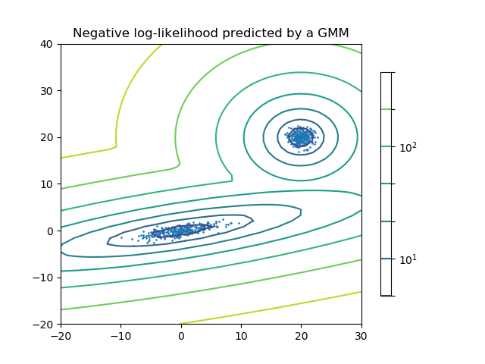
Gaussian Mixture Model
Two-component Gaussian mixture model: data points, and equi-probability surfaces of the model.

Slide 24
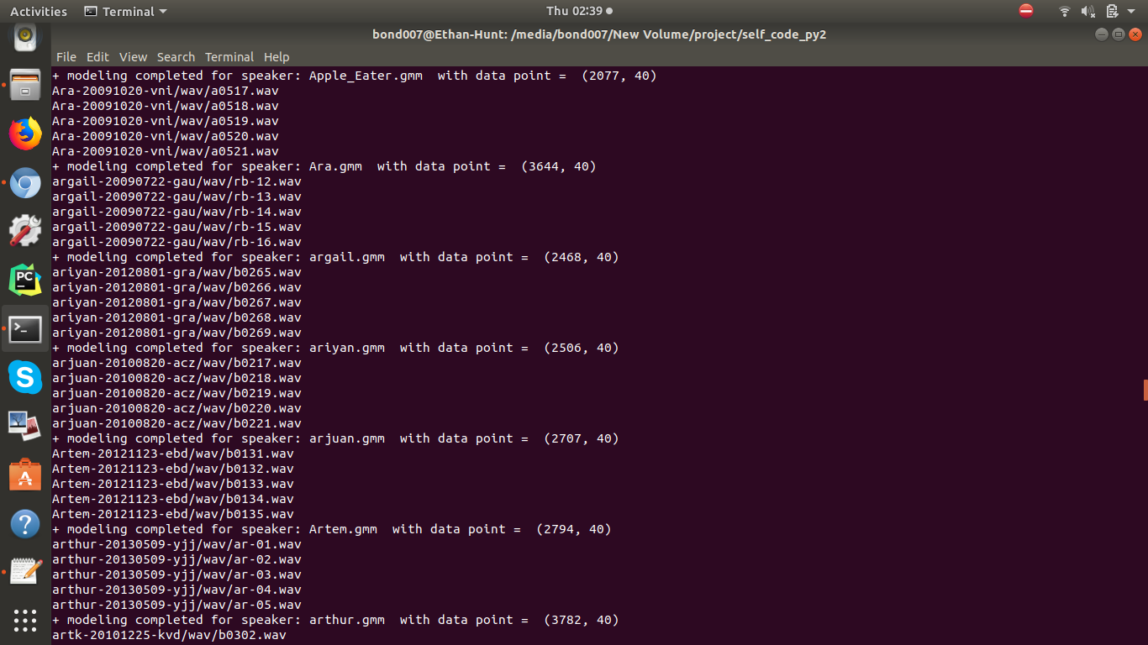
Model Training:
VoxForge – Model Training

Slide 25
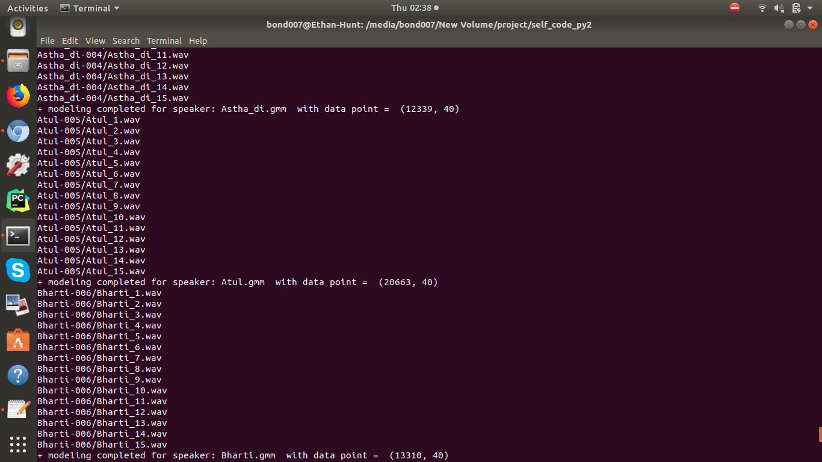
Model Training:
Self Made Dataset – Model Training

Slide 26
Perform Identification:
The log-likelihood for each .gmm model of every speaker was calculated in the model training phase. It was stored as a database in a separate folder. This data dictionary is used for matching 1: N speaker’s gmm file.
The speaker with the highest score is chosen and identified

Slide 27
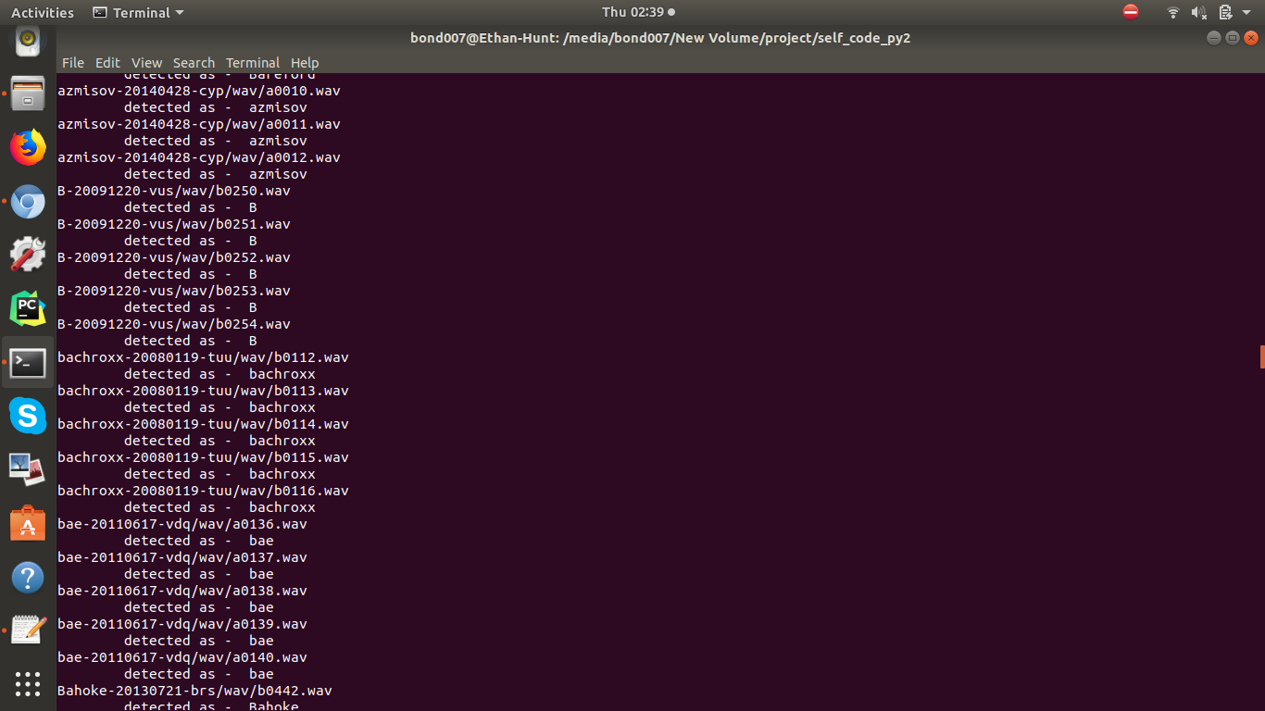
Perform Identification
VoxForge – Testing : identification

Slide 28
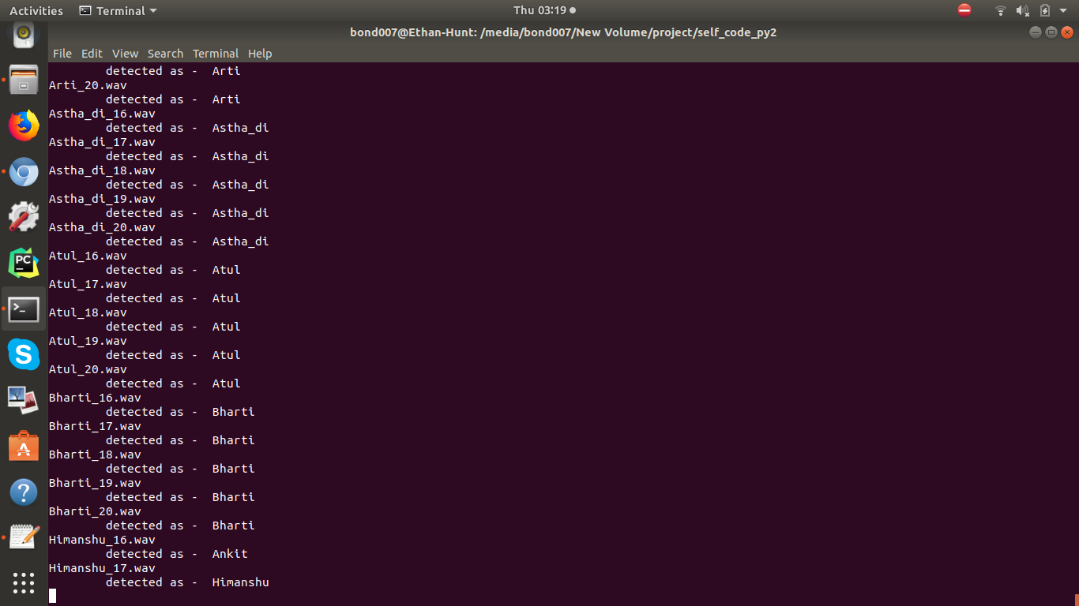
Perform Identification:
Self Made Dataset – testing: identification

Slide 29
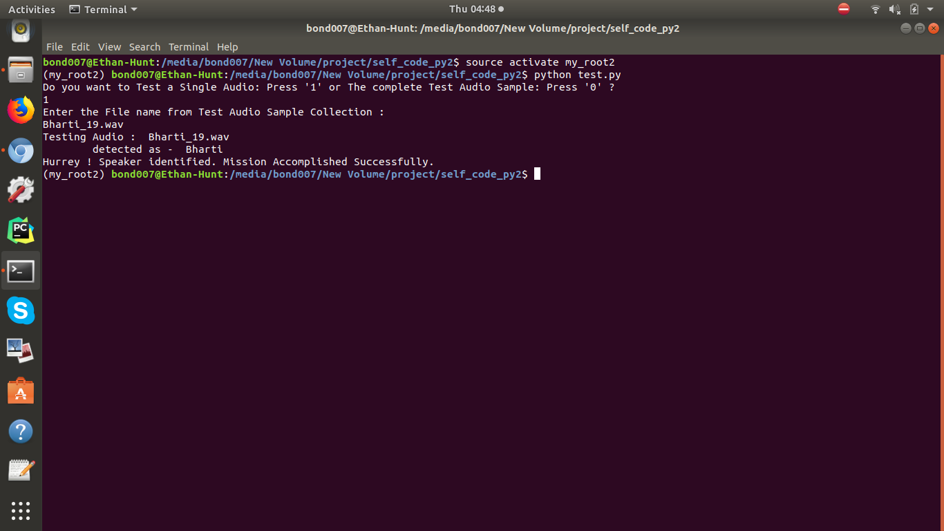
Perform Identification:
Single Audio file – Testing : identification

Slide 30
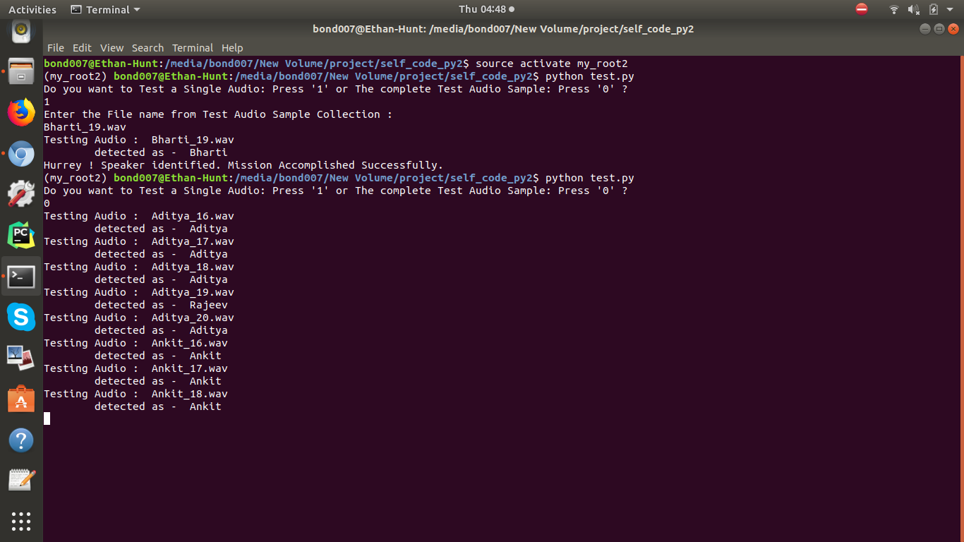
Perform Identification:
Complete test data – testing: identification

Slide 31
System Analysis
Data Dictionary:
1. VoxForge:
-> 34 speakers each accompanied 5 voice samples for training data. And 5 voice samples for testing data. So, total of 340 cleaned and pre-processed voice sample Data. Each voice sample was around 4 sec. in length. So default value of nfft = 512 in mfcc() just worked fine.
2. Self-Made Dataset:
-> 17 speakers each accompanied 15 voice samples for training data. And 5 voice samples for testing data. So, total of 340 voice sample Dataset. Each voice sample was around 30 sec. to 1 minute 40 sec in length. So, we had to tune parameters in mfcc(). We adjusted nfft values from 512 to 2000 to 1800 to 1500, finally.

Slide 32
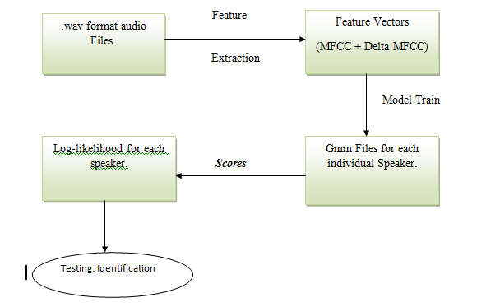
State Transition Diagram

Slide 33
Result:
> speaker identification was successfully conducted with an outstanding result on both of those datasets. The accuracy was 100% in case of VoxForge Dataset; and 95.29 % in case of self made Dataset. Thus, MFCC- GMM model gives satisfactory results.

Slide 34
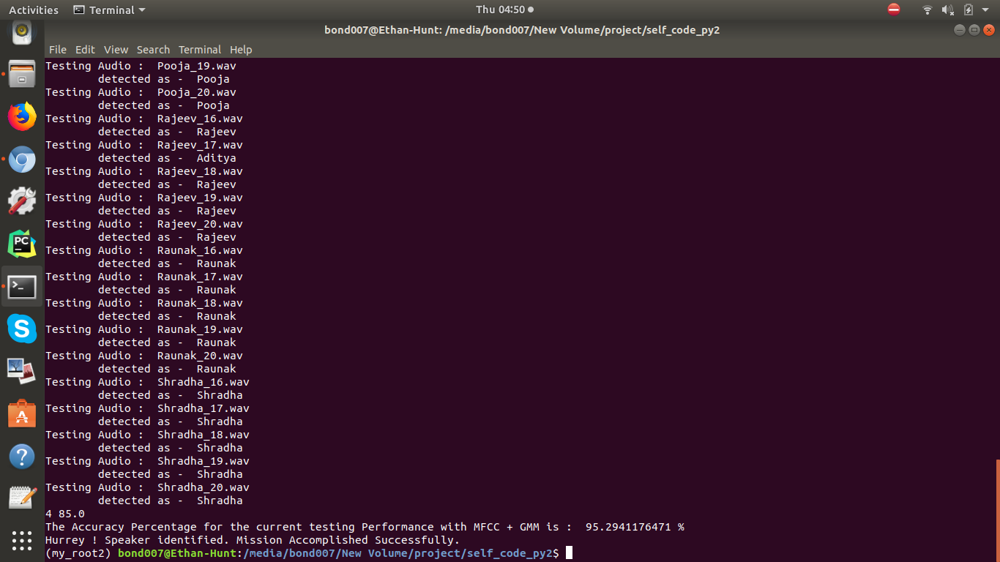
Result:

Slide 35
Future Scope:
My project can be further extended with a GUI interface for ease in user experience. If we talk about its applicability, it has enormous future scope. The procedure followed and outputs from my project would be helpful for other researchers. They can find and suggest new methods to improve accuracy and consistency of the model.
This particular project can be used as a voice biometric system to identify and catch criminals. I have a vision of extending this project further by adding Speech Recognition into this project. Speech Recognition + Speaker Recognition would serve perfect for my purpose. I would like to make an intelligent system that can start tapping phone calls when getting any vulnerable keywords, mostly used by terrorists; then the speaker recognition system would recognize that terrorist or other criminal. This would help a lot in reducing crime and terror attacks in our country.

Slide 36
Bibliography/References
1. Dalei Wu, Andrew Morris, Jacques Koreman; MLP Internal Representation as Discriminative Features for Improved Speaker Recognition, 2005.
2. Mitchell McLaren; Advances in deep neural network approaches to speaker recognition, ICASSP – April, 2015.
3. Getting Started with Audio Data Analysis using Deep Learning (with case study) - AnalyticsVidhya.com
4. David Moffat, David Ronan, Joshua D. Reiss ;AN EVALUATION OF AUDIO FEATURE EXTRACTION TOOLBOXES; Nov 30 - Dec 3, 2015
5. B.Mathieu, S.Essid, T.Fillon, J.Prado, G.Richard; YAAFE, an Easy to Use and Efficient Audio Feature Extraction Software, proceedings of the 11th ISMIR conference, Utrecht, Netherlands, 2010.

Slide 37


Bharti Parmar
BETN1CS15032
CSE-A(3r^{d} Yr.)
Ankit Kumar
BETN1CS15017
CSE-A(3r^{d} Yr.)
Atul Anand
BETN1CS15028
CSE-A(2nd Yr.)
Thank You

